Slide 1
EECE 5698: Lab 4 Photo Mosaic
Andrew Tu

Slide 2
Calibration
Calibrated using 23 images of the checker board
Window size of 1px
Focal Length: fc = [ 3798.09831 3786.69369 ] ± [ 0.84810 0.86363 ]
Principal point: cc = [ 1913.48815 1754.93413 ] ± [ 1.01761 1.08005 ]
Skew: alpha_c = [ 0.00000 ] ± [ 0.00000 ] => angle of pixel axes = 90.00000 ± 0.00000 degrees
Distortion: kc = [ 0.00765 -0.08426 -0.00826 0.00672 0.00000 ] ± [ 0.00074 0.00209 0.00009 0.00009 0.00000 ]
Pixel error: err = [ 0.24405 0.24795 ]

Slide 3
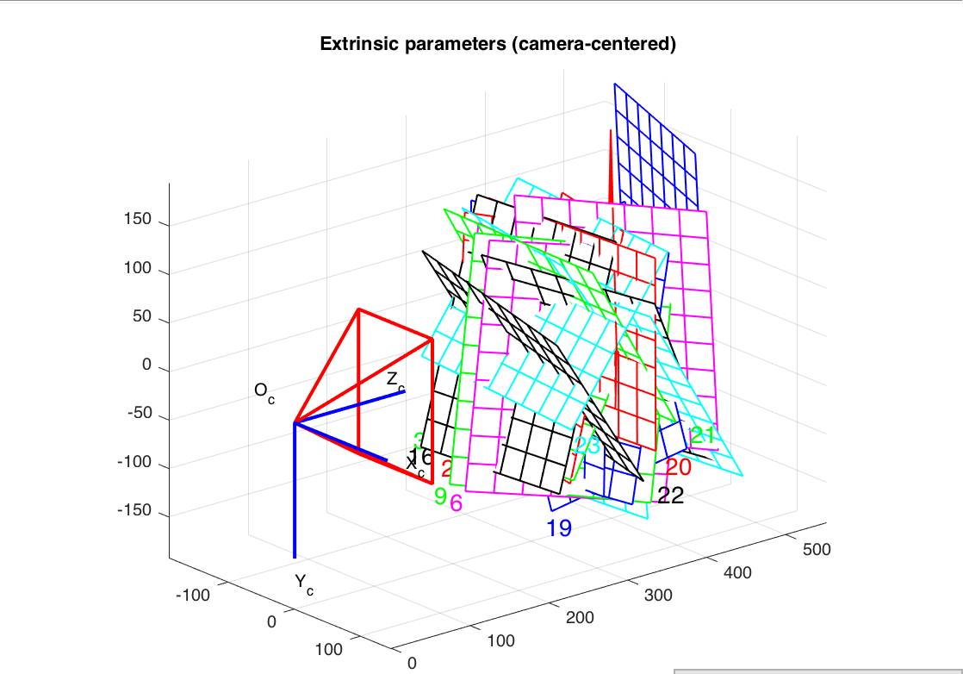
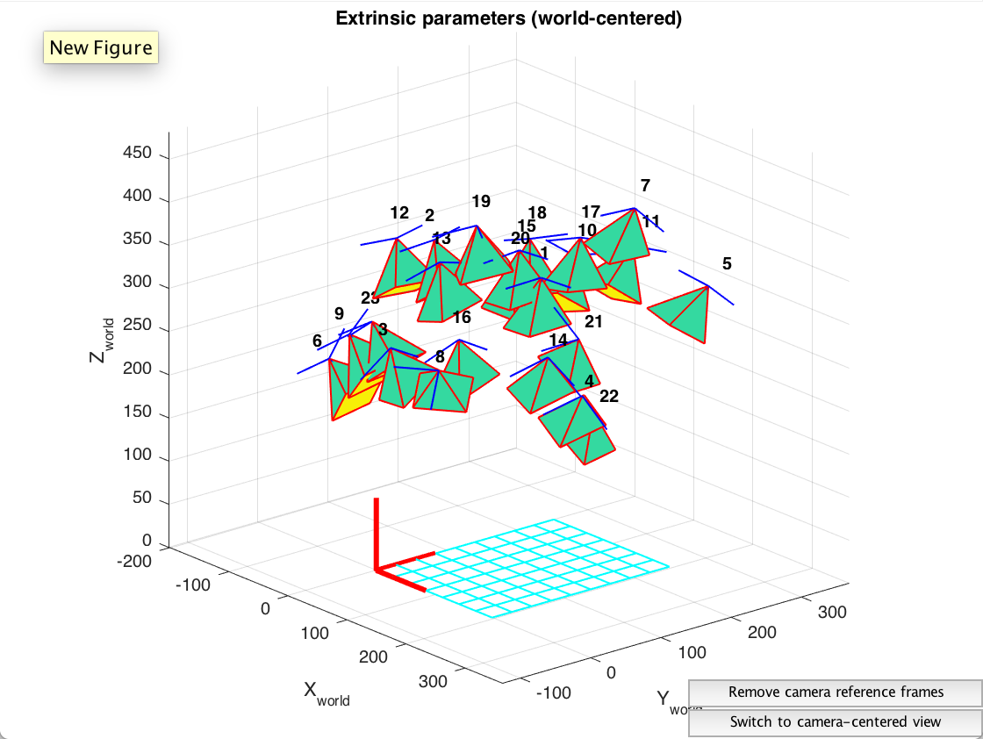
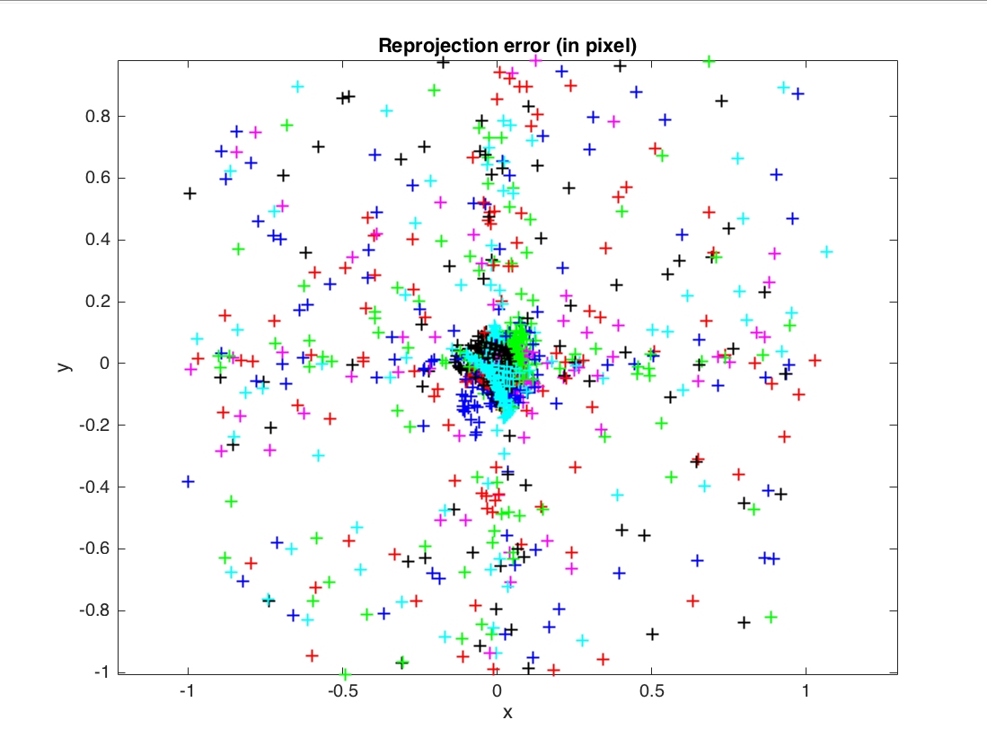
Calibration

Slide 4
Feature detection SetTing Summary
Down sampled images to 300px X 300px
1500 points taken
Broke images up into 3 tiles for feature detection
Tile 1
Tile 2
Tile 3

Slide 5
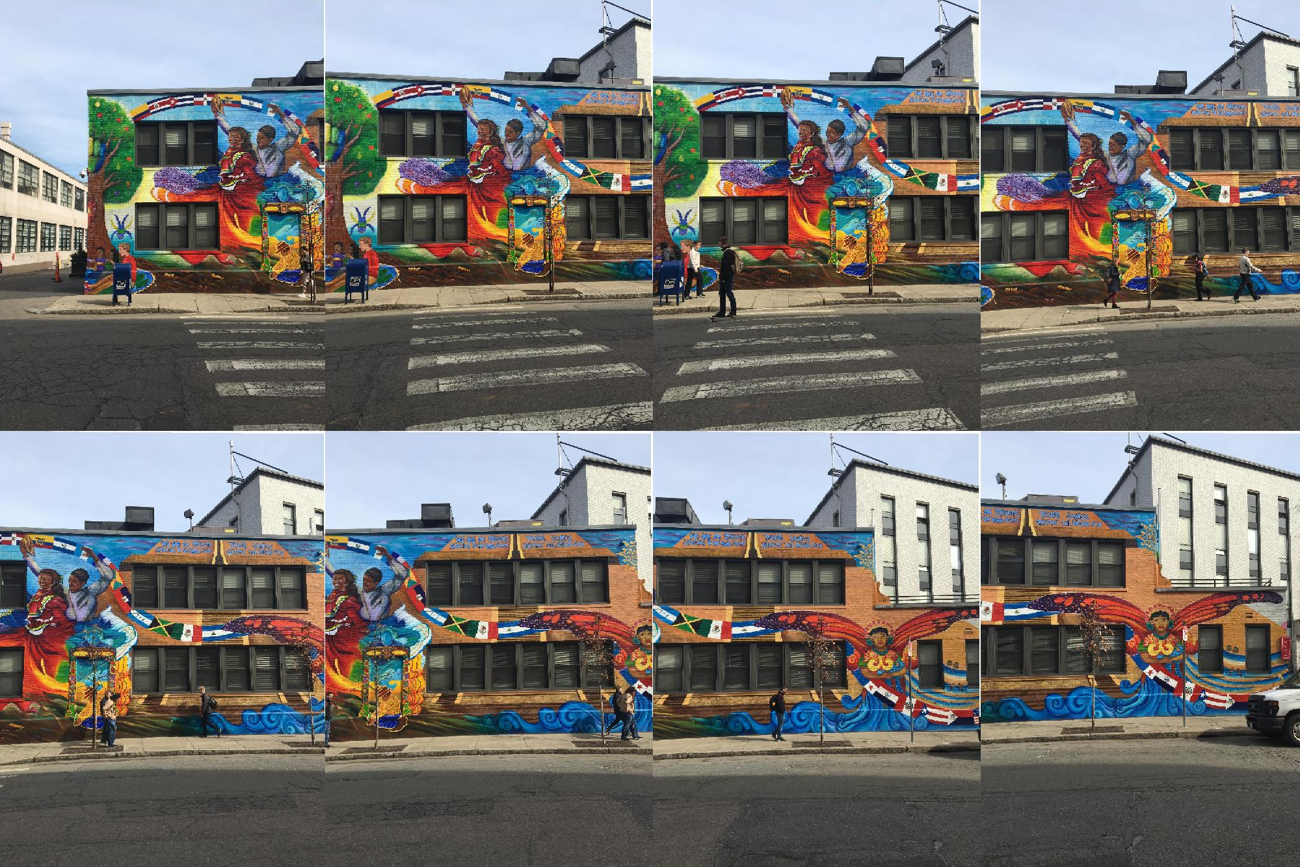
Latin American Center - Montage

Slide 6
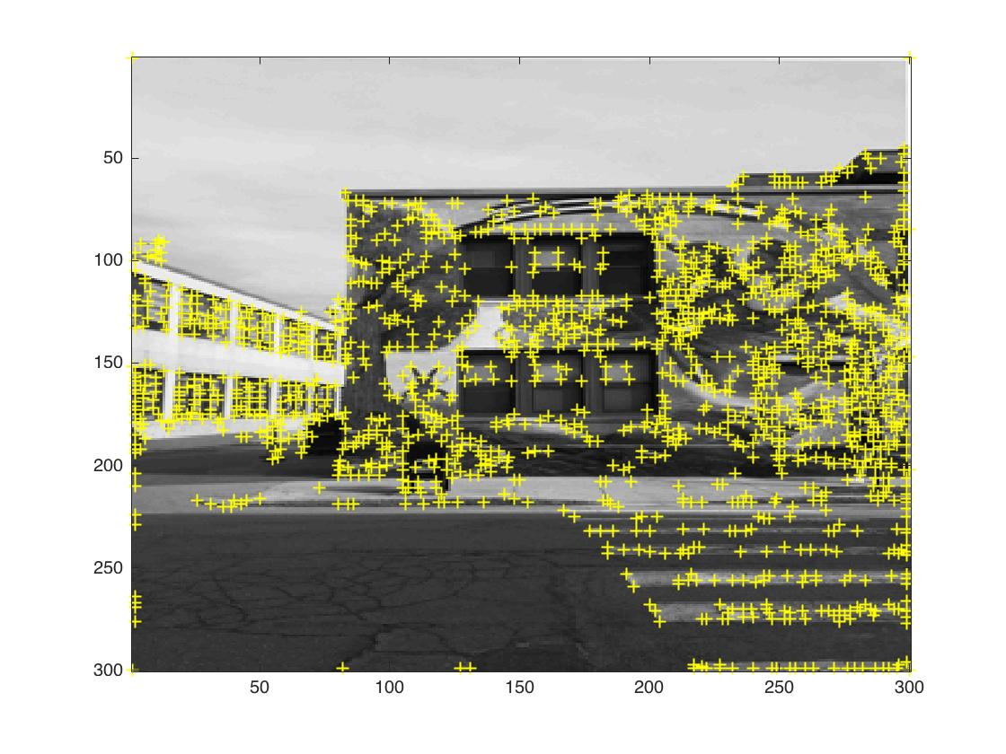
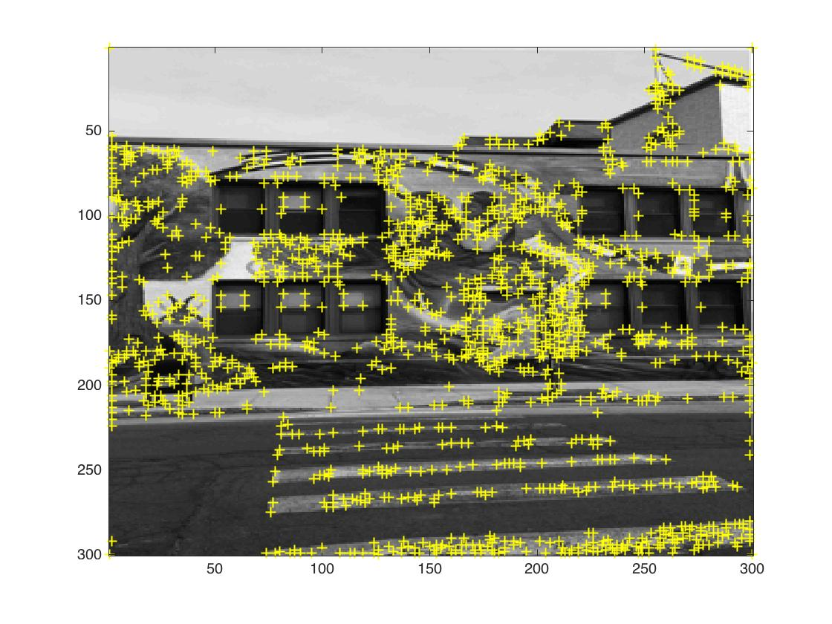
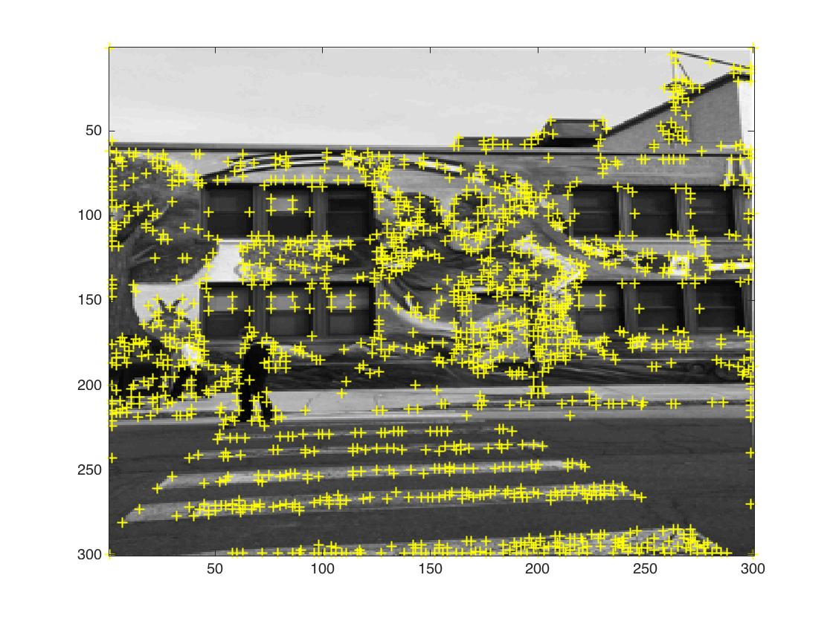
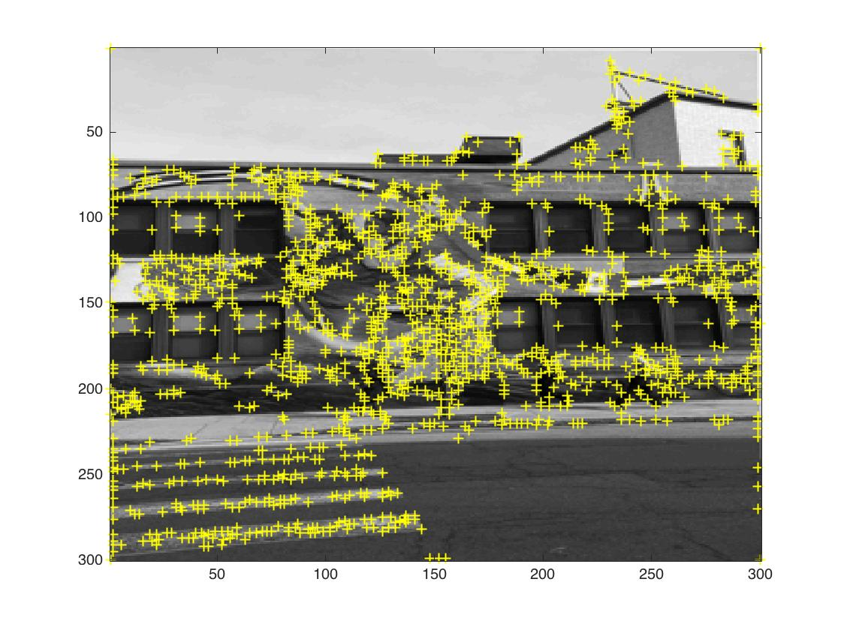
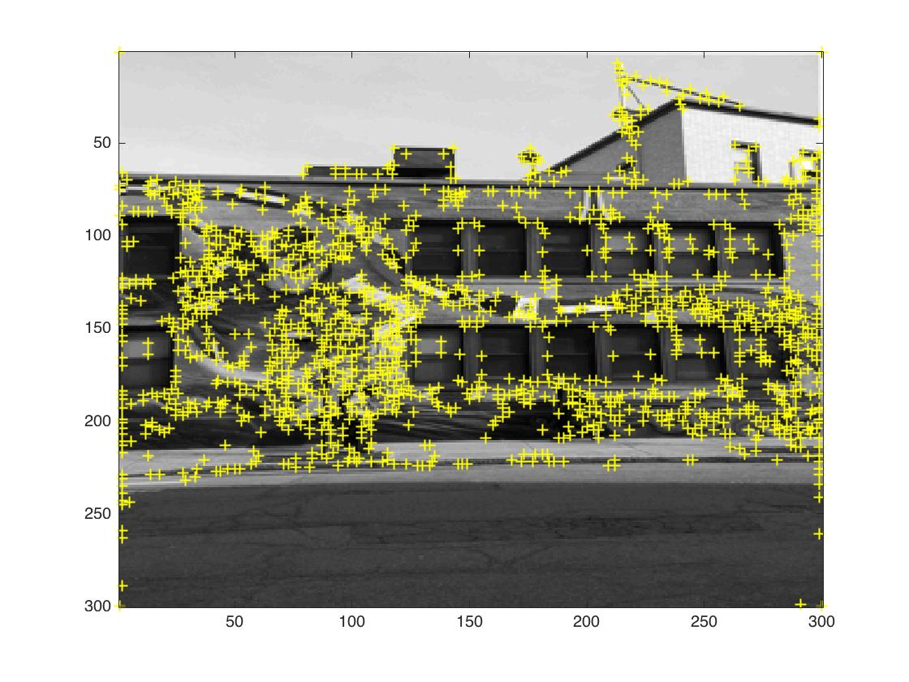
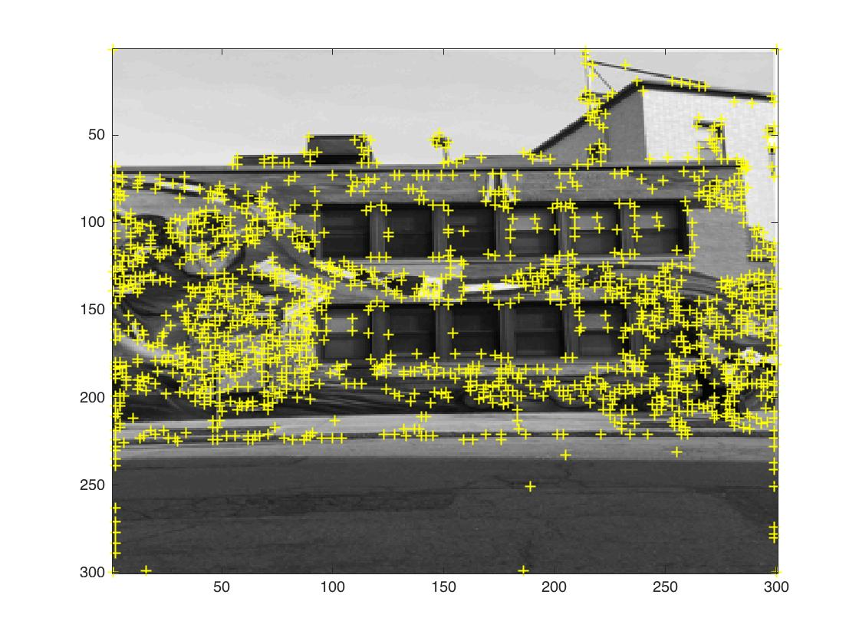
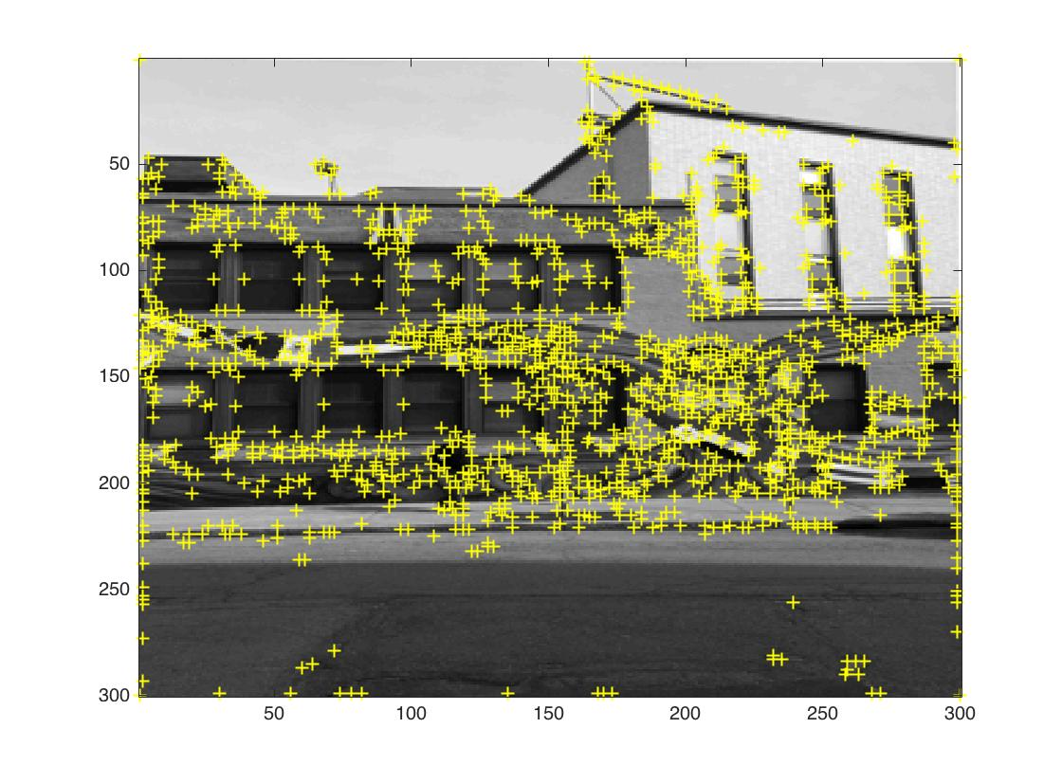
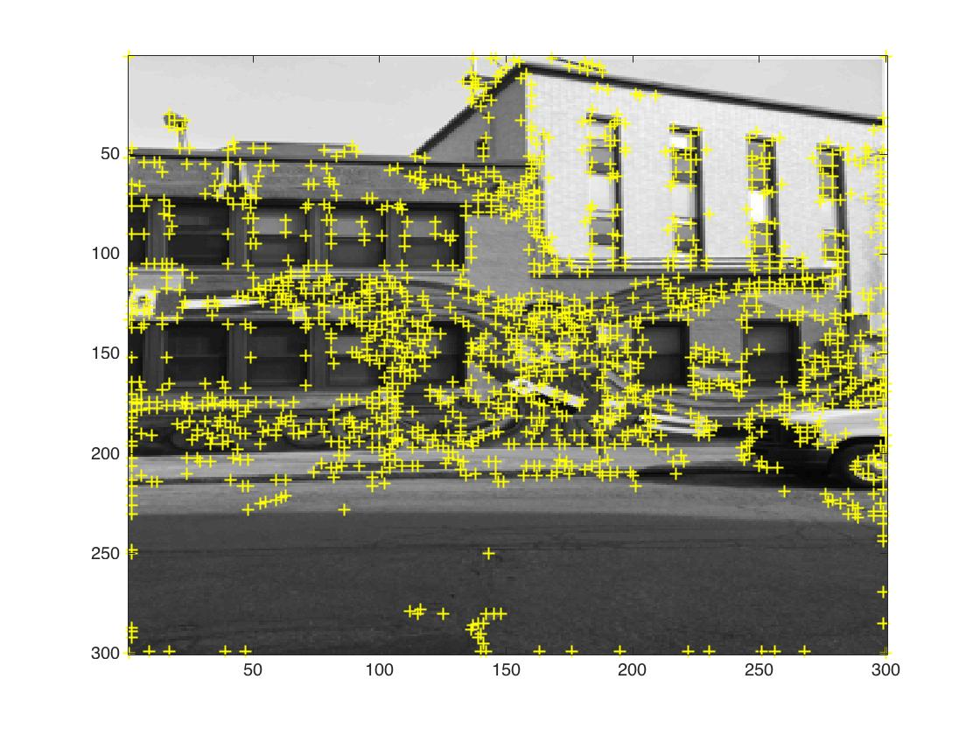
Latin American Center – Features (images down sampled to 300px x 300px)

Slide 7
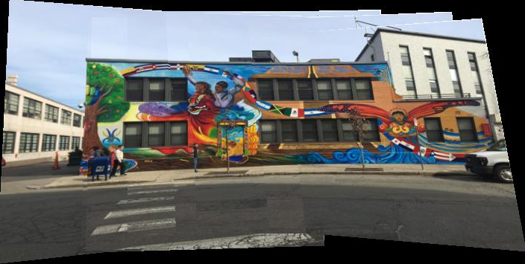
Latin American Center Pano (images down sampled to 300px x 300px)

Slide 8
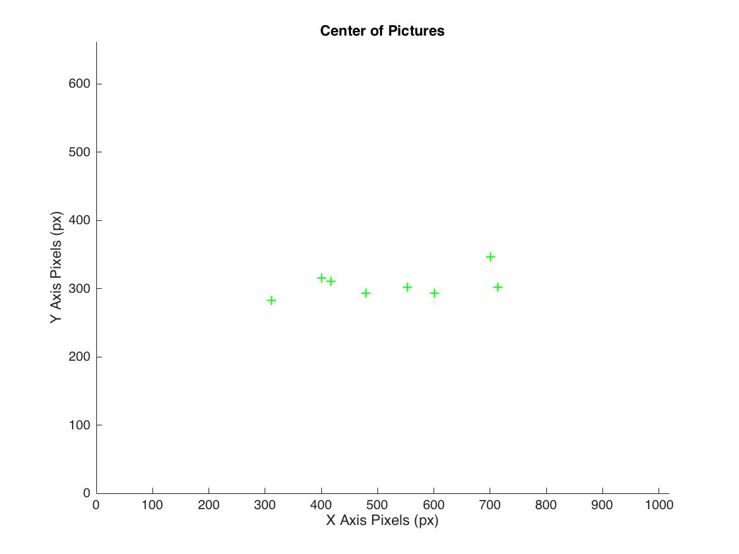
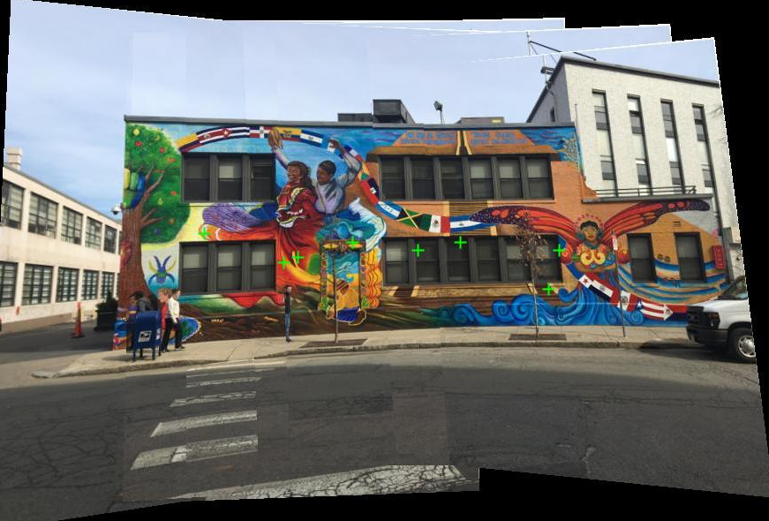
Image Centers with respect to Pano
Points overlaid onto actual panorama

Slide 9
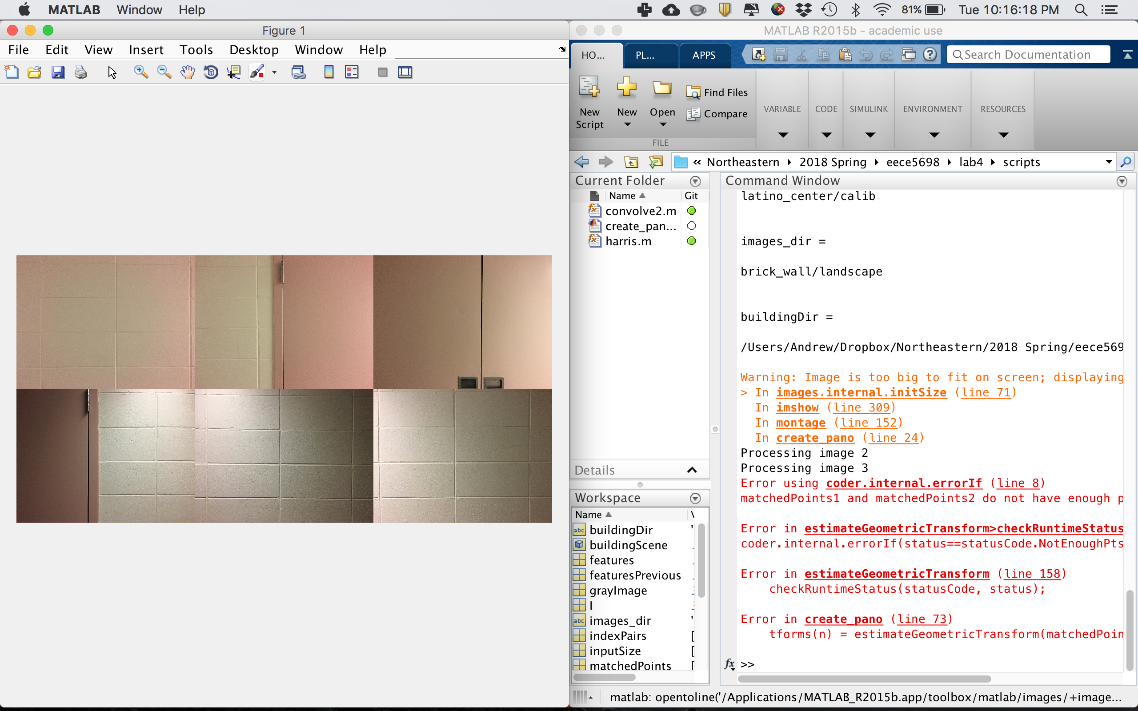
Cinder Block Wall: Not Enough Features
Image 3 didn’t have enough features to extract,
causing the code to throw an error

Slide 10
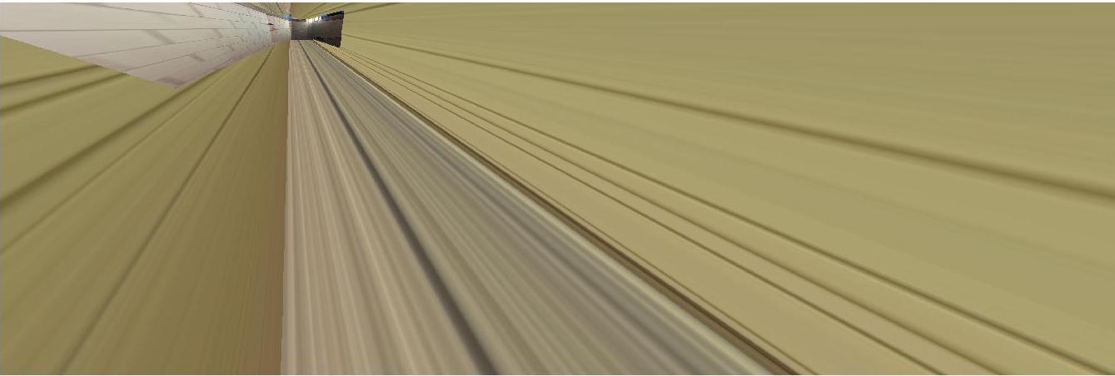
Different Cinder Block Wall (images down sampled to 300px x 300px)
Ran code on a cinder block wall with more distinct features
Still saw significant distortions when creating panorama

Slide 11
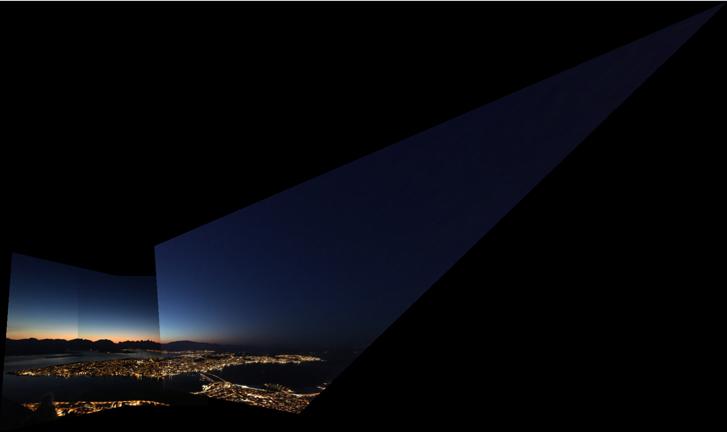
Tromsø Pano (in Place of campus)
Played around with included images
“Goldilocks” overlap amount
Too much overlap, crazy distortions of overall image
Not enough overlap, script is unable to match enough points
Need to increase the number of features found in order to match pictures with less overlap

